Slide 1
Attendee-Sourcing
Anant Bhardwaj (MIT), Juho Kim (MIT), Steven Dow (CMU), David Karger (MIT)
Sam Madden (MIT), Rob Miller (MIT), Haoqi Zhang (Northwestern)

Slide 2
The science of designing systems to collect inputs from crowd for solving hard problems.

Slide 3
Conference Scheduling
Stakeholders
Attendees
Authors
PC Members
Organizers
Notes:
Goal is to build a schedule that best accommodates preferences and constraints of attendees, authors, program committee members, and organizers

Slide 4
A typical large conference (Ex: CHI)
4 days
More than 500 papers
16 parallel sessions
Notes:
This is how a large multi-track conference looks like.

Slide 5
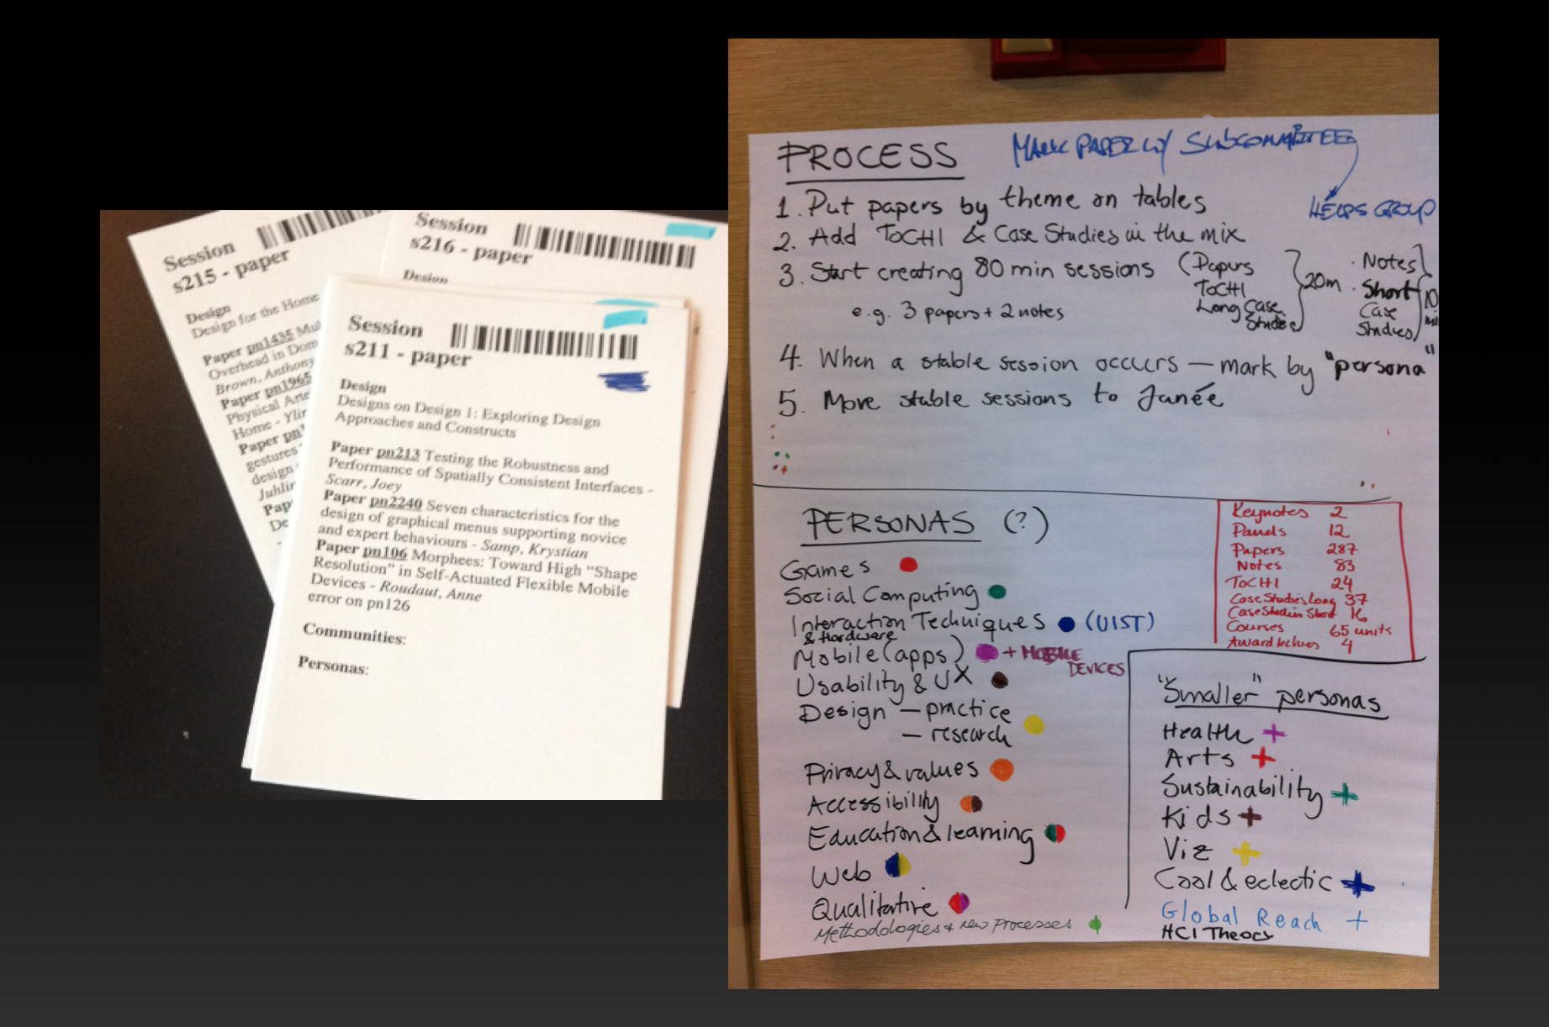
Paper Based Process
Notes:
Put papers by themes on tables (typically done by subcommittees and help groups)
Start creating 80 minutes sessions
Once a session is created, mark it by persona (personas are like high level themes – such as games, usability, crowd-sourcing, design, etc..)
Program committee would create a rough preliminary schedule from theses sessions

Slide 6
Notes:
The outcome of the process is a rough preliminary schedule created by program committees
The next step is to look at this rough schedule and further refine it.
Mainly resolve conflicts (don’t schedule two authors at the same time, don’t schedule two sessions-chairs same time, remove stray papers)

Slide 7
Paper Based Process
Stakeholders
Attendees
Authors
PC Members
Organizers

Slide 8
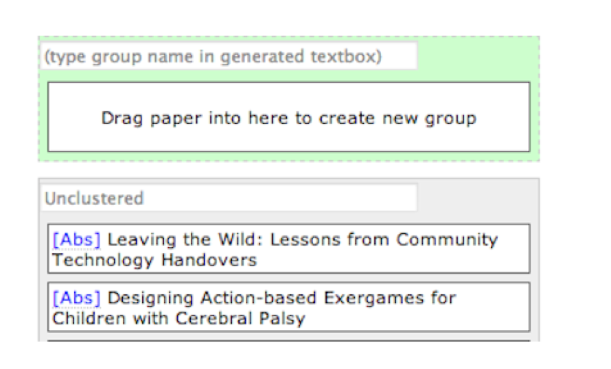
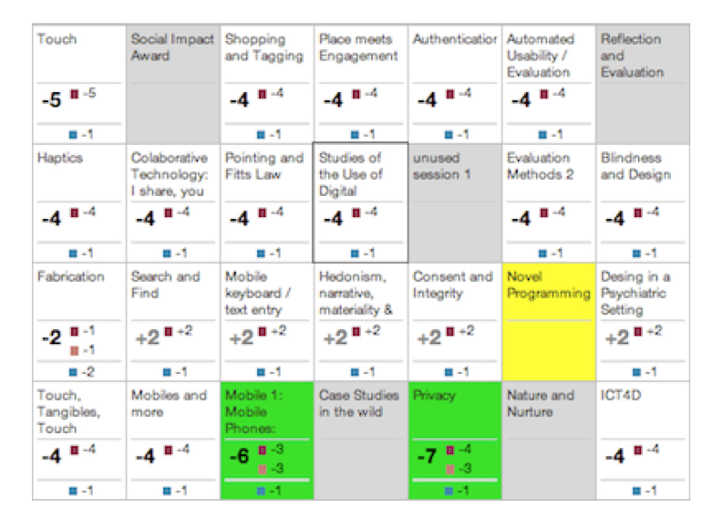
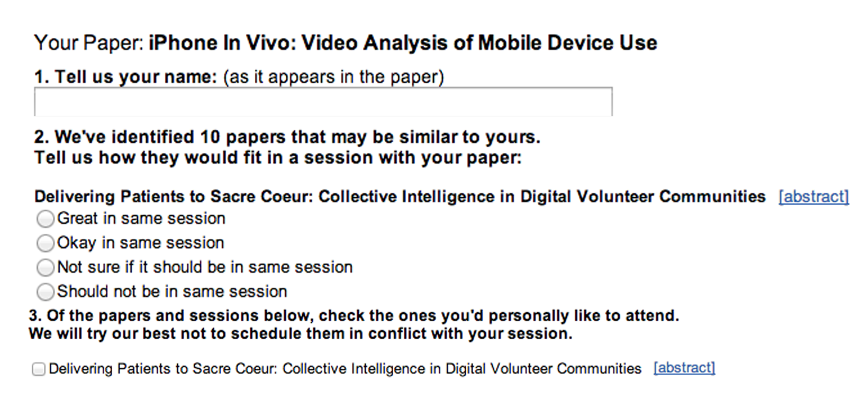
Prior Work [Cobi, Kim et. al.]
Committee-Sourcing
3. Scheduling Interface
2. Author-Sourcing
Notes:
Engage community members
Three Step Process
Committee-Sourcing
ask committee members to group papers in their specific areas of expertise
Author-Sourcing
invite the authors to identify papers that would fit well in a session with their own, and the papers they like to see
A Scheduling Interface
A scheduling interface for highlighting conflicts
Provides useful data for scheduling
fine-grained information about which papers should appear in the same session
conflict information *from authors*

Slide 9
Cobi
Stakeholders
Attendees
Authors [partially]
PC Members
Organizers
Notes:
1. There could be other papers which should be in the same session
2. Authors *may* want to see more papers than those in the presented list
The limitation of the process itself. You can’t do better.
3. For a good schedule, all attendees’ inputs are crucial – especially committee members and authors are small in number compared to the entire community.

Slide 10
Attendee-Sourcing
Collect useful data from attendees to help in conference scheduling.
CAVEATS
Attendees have no interest/incentive in helping in conference scheduling
SOLUTION
Give attendees a tool that they selfishly use for their own benefits and we collect useful data as a by-product of their usage of the tool.
Notes:
Attendees are typically interested in finding interesting papers and talks relevant to their interest.

Slide 11
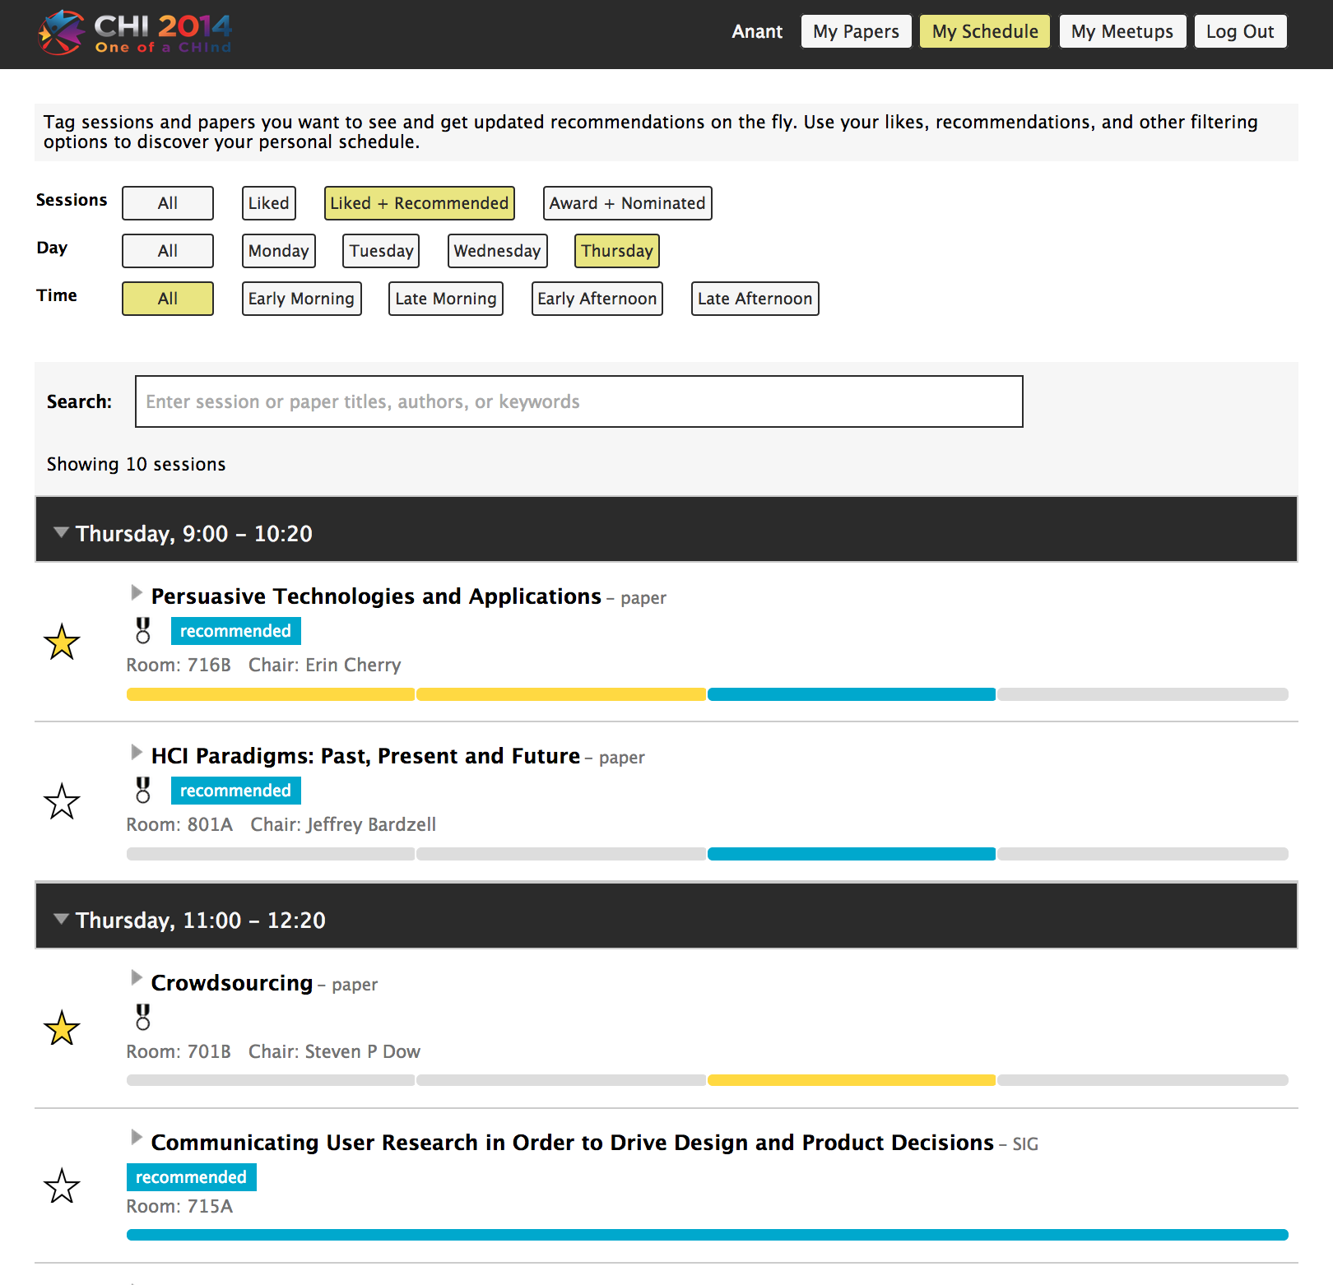
Introducing Confer [A tool for Attendee-Sourcing]
Confer helps attendees find/explore interesting papers and build a personal schedule.

Slide 12
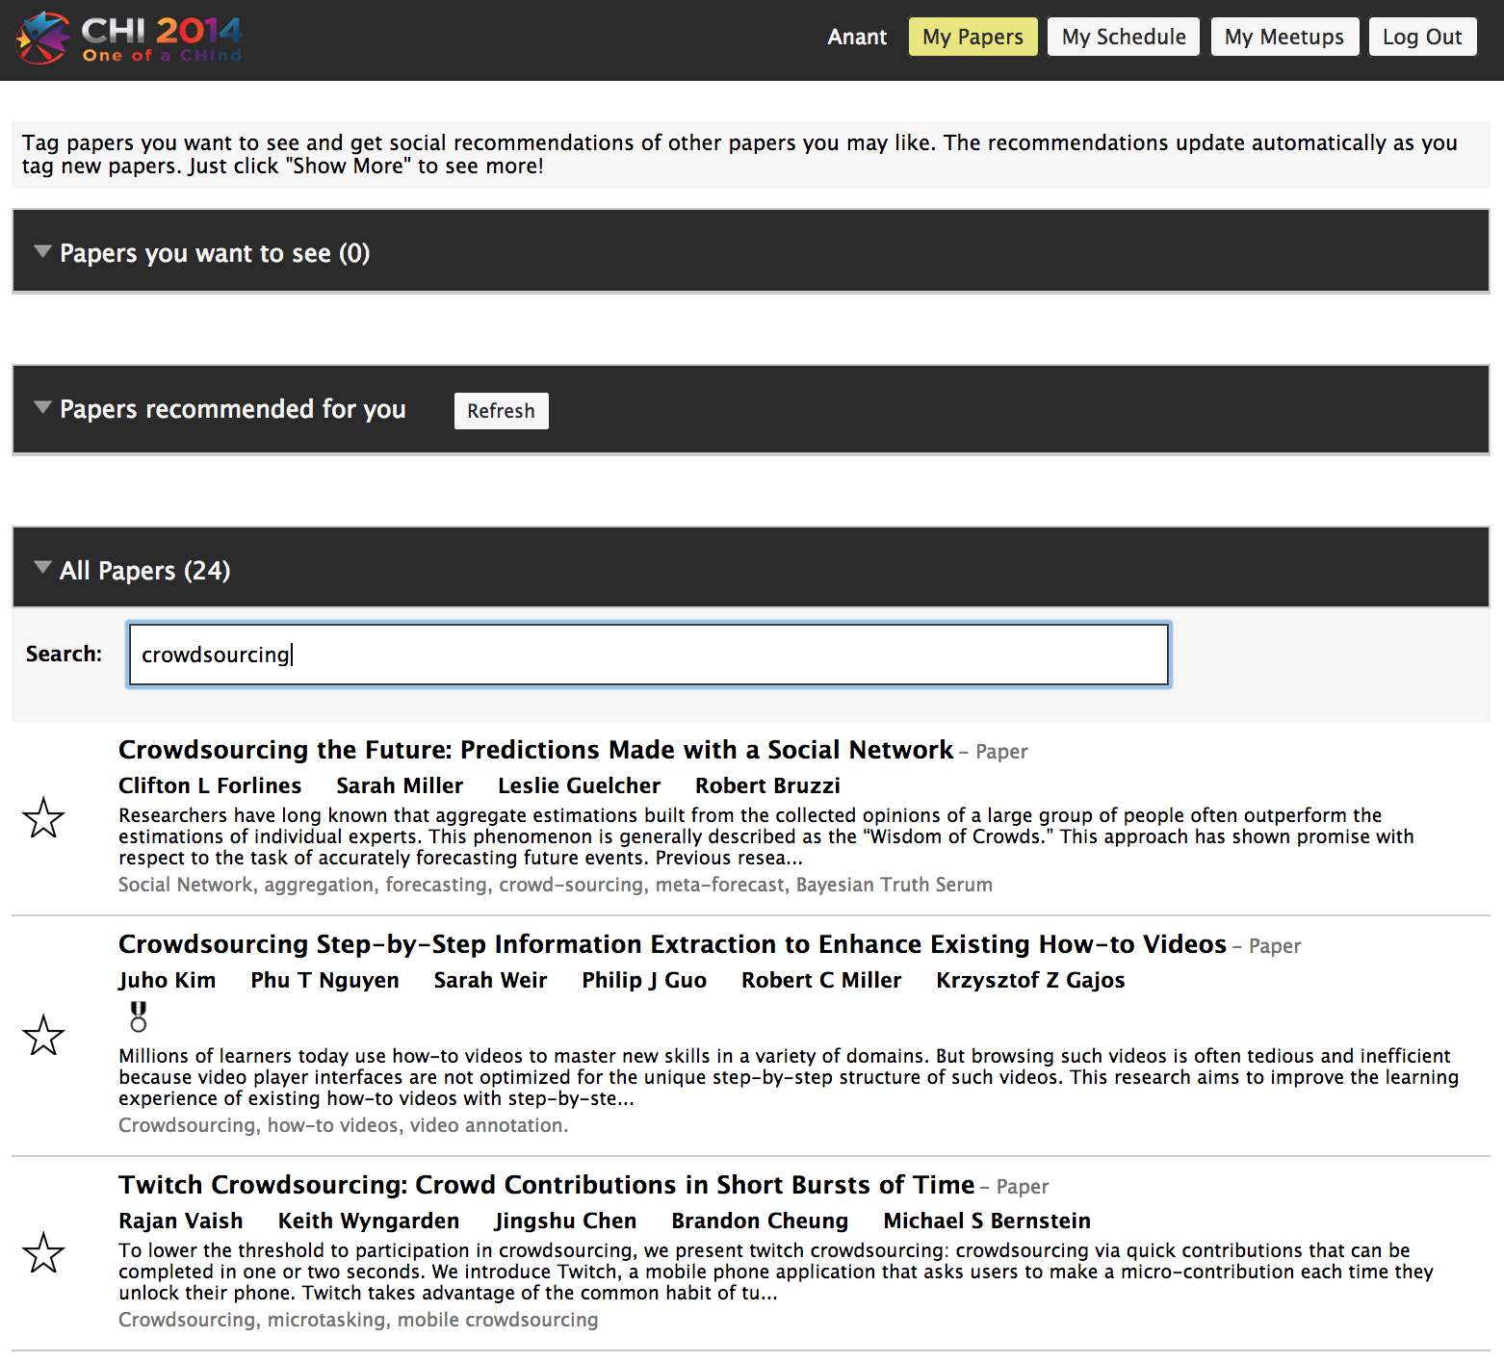
Confer
Notes:
You go, search for paperd using keywords, author names, affiliations, etc..

Slide 13
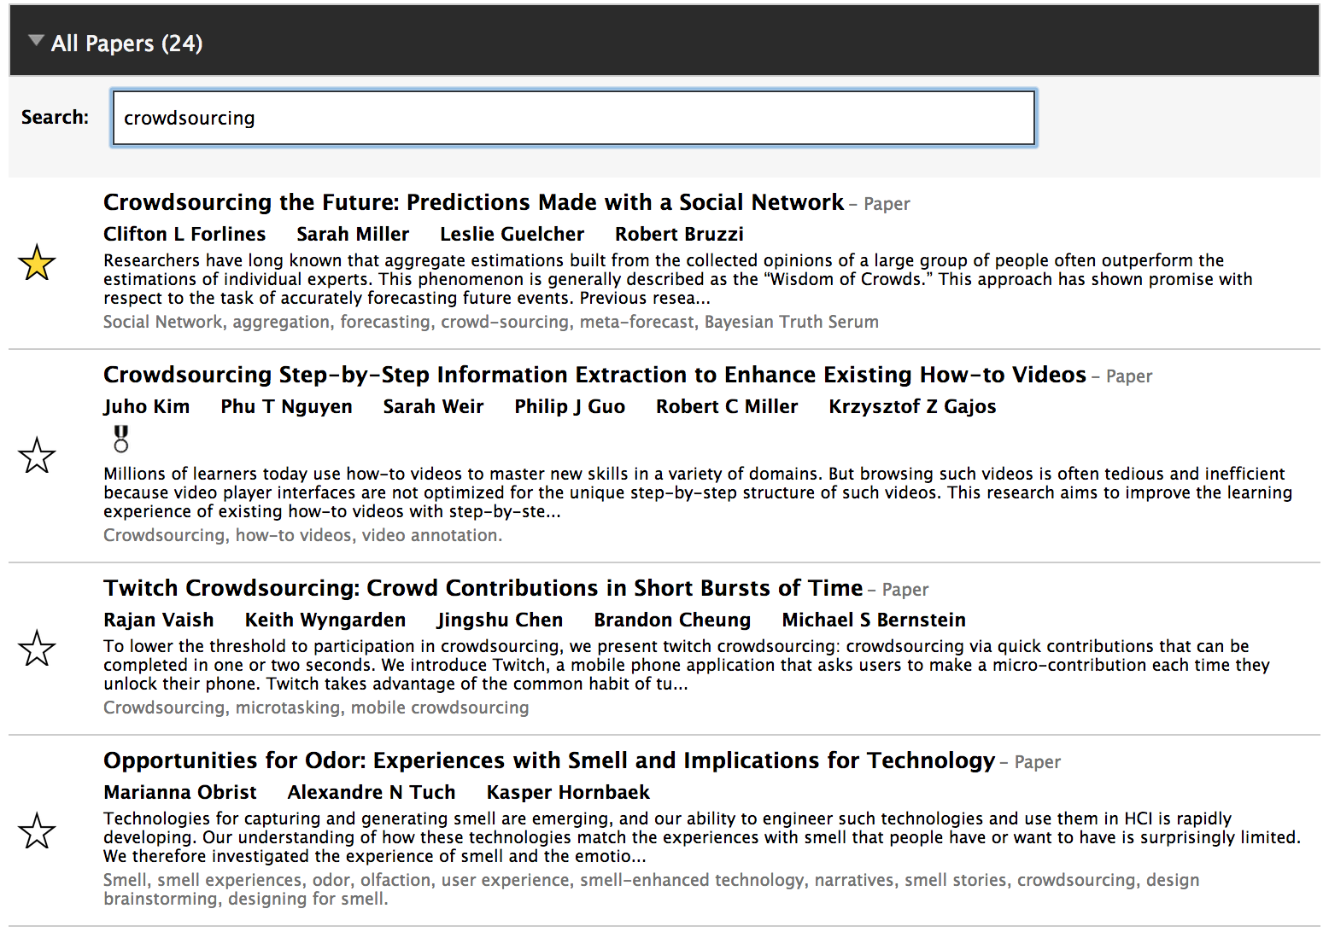
Confer
Notes:
If you find something something interesting, you can star it which adds the papers to your preference list

Slide 14
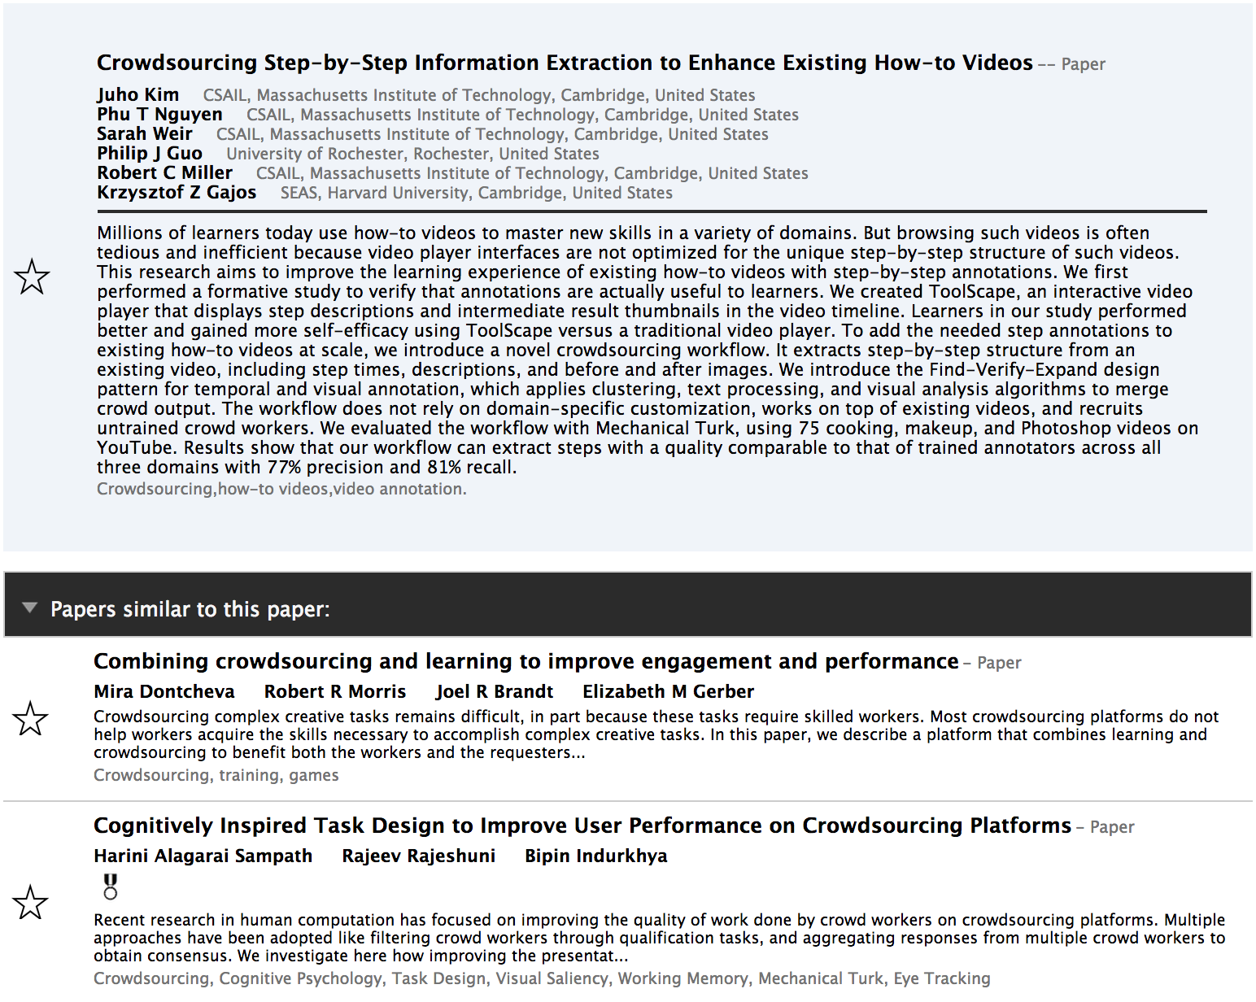
Confer
Notes:
Also, when you are looking at a paper, it shows papers similar to that paper – this is to help discover related papers in an area because if you like a paper you are likely to like similar papers in that area too.

Slide 15
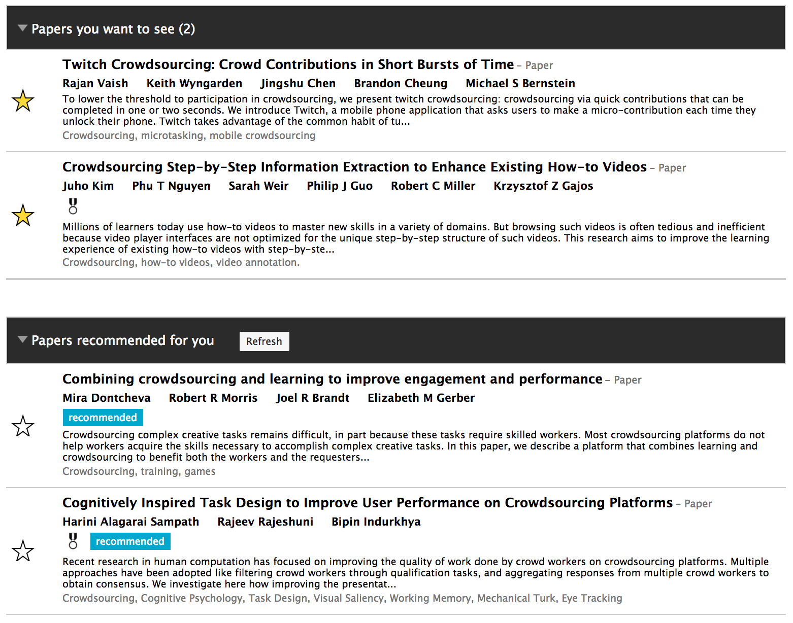
Confer
Notes:
And based on all the papers you have marked, it will recommend other papers you are likely to find interesting. These recommendations use collaborative filtering approach. You can see many crowdsourcing papers recommended to me because I have marked crowdsourcing papers in my preference list.

Slide 16
Confer
Notes:
At the end, you get this nice personalized schedule, which will help you decide where to spend your time in the conference.

Slide 17
Prior Knowledge [Based on Past Deployments of Confer]
Attendees use Confer immediately once conference is available on Confer
They search for papers and explore related papers
While exploring, they add interesting papers to their preference list.
Notes:
Attendees want to get an early preview of all the accepted papers they can explore and interact with,
Attendees search for papers from a specific author, specific institution, related to a keyword, etc…

Slide 18
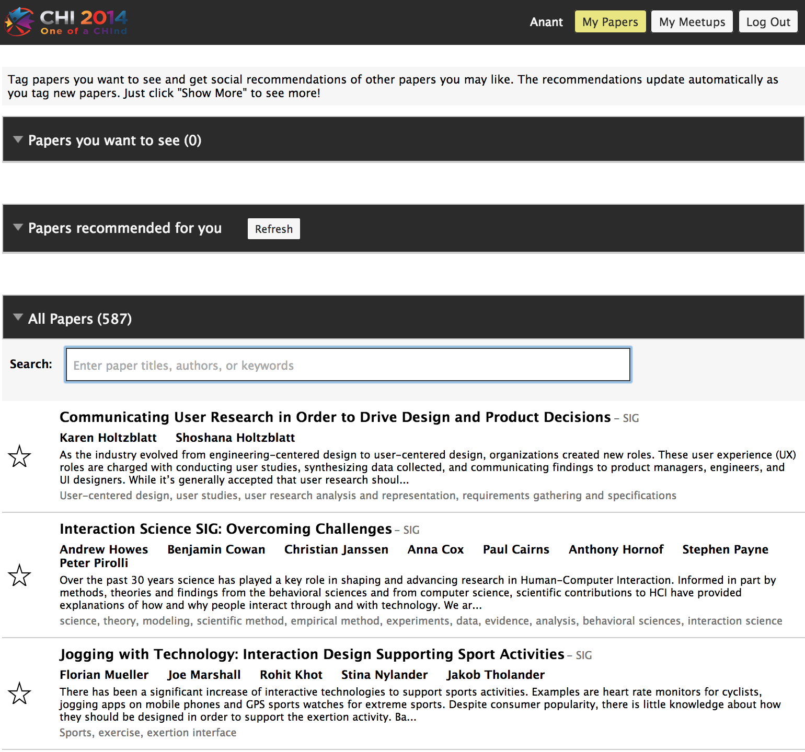
Attendee-Sourcing
No Schedule
60-90 days before the schedule announcement.
Notes:
So here is the idea: why not release the list of accepted papers as soon as you have them (without any schedule information) and hopefully, you will get enough data that can be useful for conference scheduling.

Slide 19
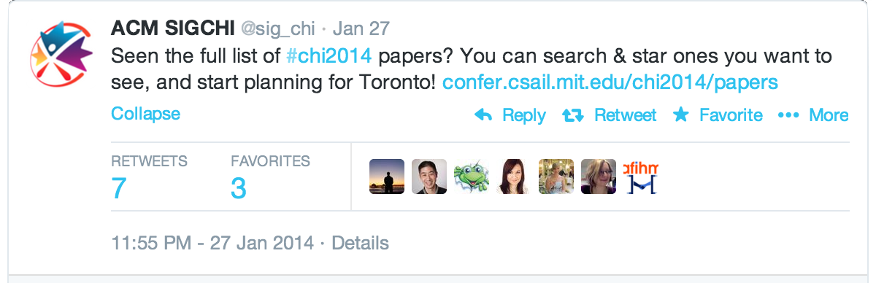
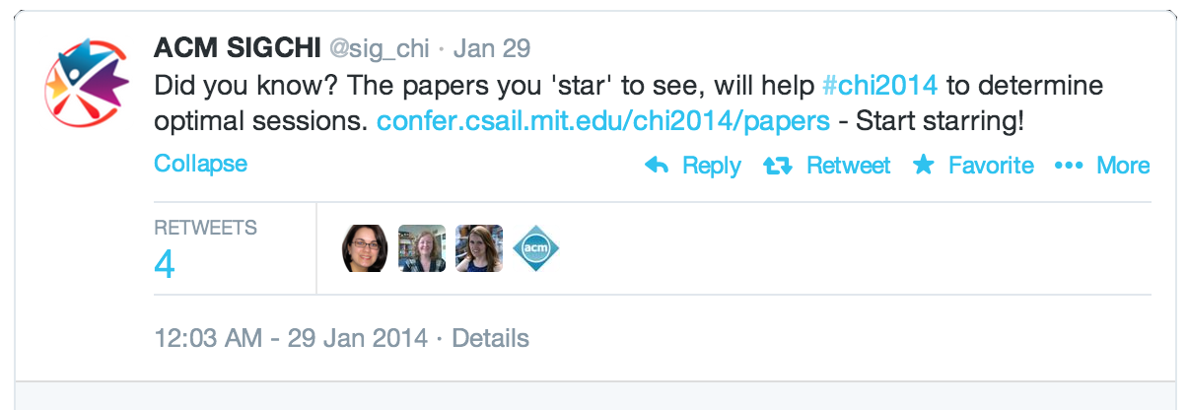
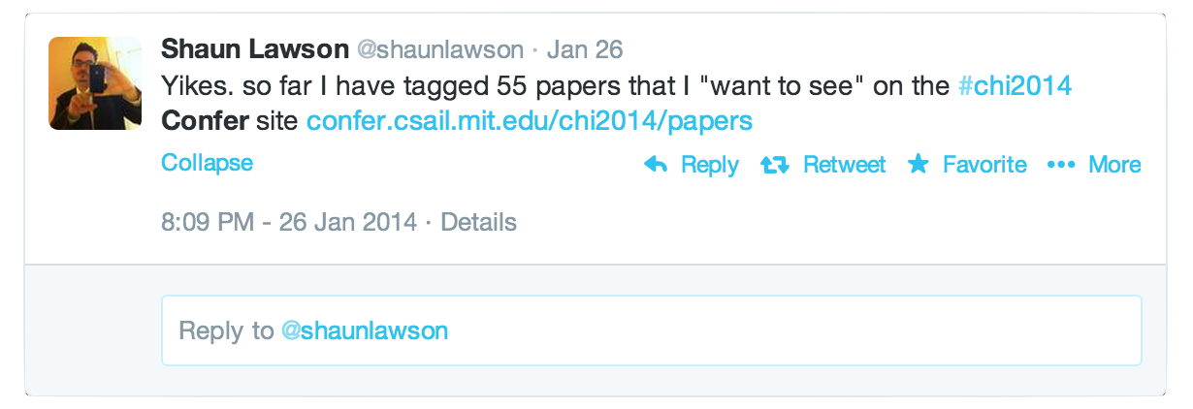
Attendee-Sourcing
Advertise! Advertise! Advertise!

Slide 20
Hypotheses
H1: Attendee-sourcing will discover all the paper similarities that are discovered in committee-sourcing + author-sourcing
H2: Attendee-sourcing will also discover paper similarities that are missed in committee-sourcing + author-sourcing

Slide 21
Attendee-Sourcing Result (CHI 2014)
 | # Participants | Total # Preferences Marked | % Papers Covered | # Preferences per Participant
Author-Sourcing | 634 | 3, 869 | 91.14% | μ: 6.1, σ²: 3.86, M: 5
Attendee-Sourcing | 347 | 7, 228 | 98.98% | μ: 20.83, σ²: 21.47, M: 14
As attendees, authors want to see more papers.
Attendee-sourcing provides more coverage.
Attendee-sourcing generates more preference data points, with less participation.
Notes:
One of the issues we had earlier mentioned wile discussing Cobi was authors have no way to mark papers beyond the 10 or 20 papers they are presented with.
If authors of a paper don’t respond, you miss data-points on that paper

Slide 22
Paper Similarity Capture
0 pair
Author-Sourcing: Strong Similarity.
Attendee-Sourcing: Weak or No Similarity
402 pairs:
Author-Sourcing: Weak Similarity
Attendee-Sourcing: Strong Similarity.
150 pairs:
Author-Sourcing: No Similarity (missed)
Attendee-Sourcing: Strong Similarity (discovered).
Notes:
As we saw, for attendee-sourcing the expected number of attendees who want to see a paper is 12.44; if a pair of papers is in the preference list of more than 10 attendees, we consider it a strong signal for relevance. Similarly, for author-sourcing the expected number of authors who want to see a paper is: 7.23; if a pair of papers is in the preference list of more than 5 authors, we consider it a strong signal for relevance.

Slide 23
Using Attendee-Souring Data for Scheduling
Create Sessions
a set of papers a lot of attendees want to see - same session.
create clusters based on papers’ similarity
Reduce Conflicts.
papers many attendees want to see: don’t schedule at the same time

Slide 24
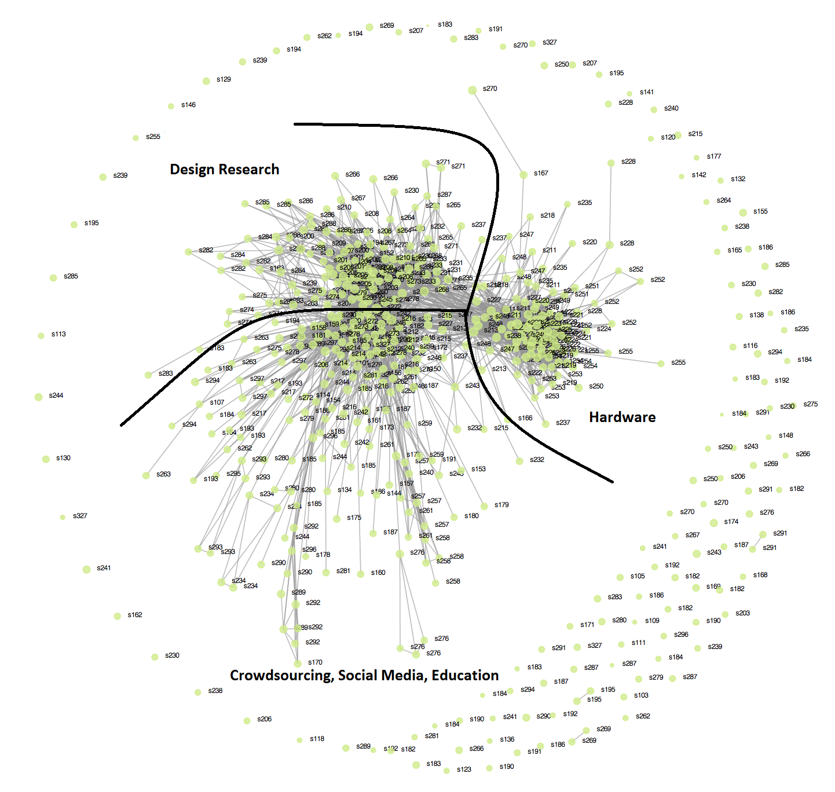

Slide 25
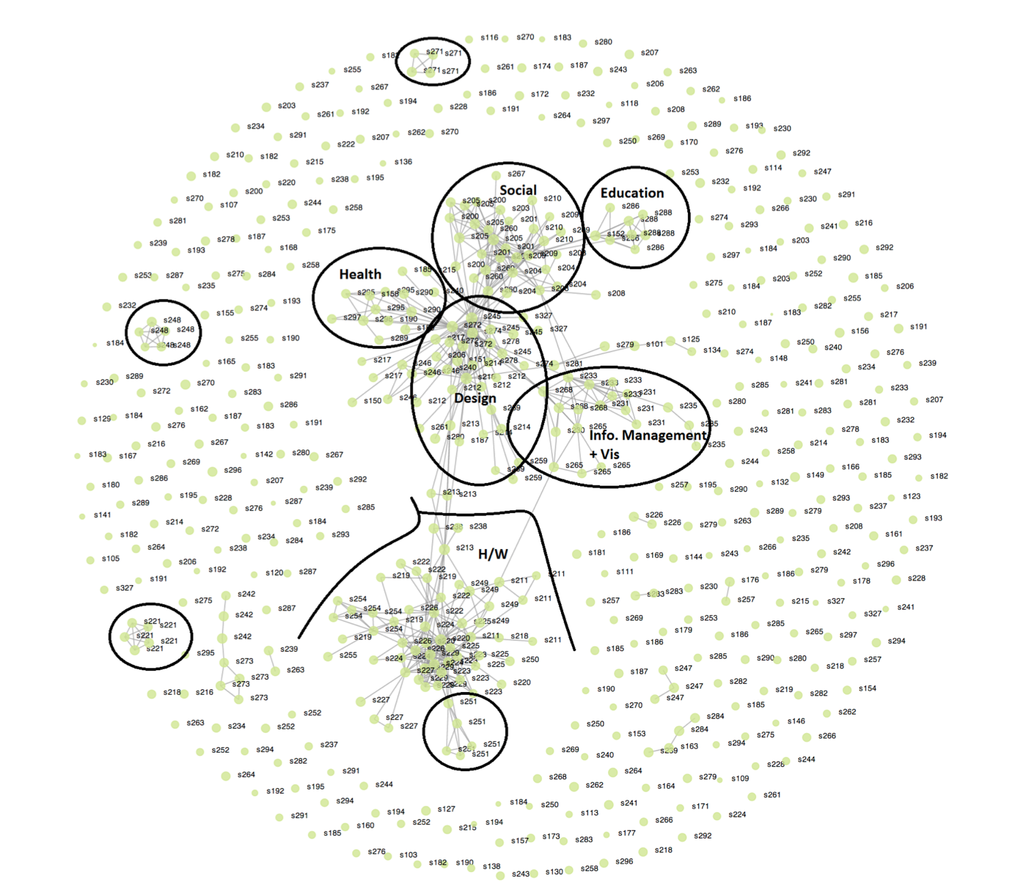

Slide 26
Using Attendee-Souring Data beyond Scheduling
Rooms
put popular papers in bigger rooms
Keynote speakers, panels, workshops, etc.
Understand trends, community network, etc.

Slide 27
Author-Sourcing vs. Attendee-Sourcing Nature of Data
Author-Sourcing:
personal biases: my paper in a good session
Attendee-sourcing
by-product of a natural exploration by attendees.
possible bias: social media, popularity

Slide 28
Author-Sourcing vs. Attendee-Sourcing Nature of Data
Author-Sourcing validates similarity
High precision (cost: misses a lot on recall)
Attendee-Sourcing discovers similarity
High recall (cost: some false positives)
Notes:
Let’s see some examples

Slide 29
Confer + Cobi
Both the process have certain biases
combine Attendee-Sourcing + Author-Sourcing
Engage all community members
Attendees
Authors
PC Members
Organizers
Notes:
1. There could be other papers which should be in the same session
2. Authors *may* want to see more papers than those in the presented list
The limitation of the process itself. You can’t do better.
3. For a good schedule, all attendees’ inputs are crucial – especially committee members and authors are small in number compared to the entire community.

Slide 30
Takeaways
Engage all community members
Different incentives, methods, and interfaces are needed for collecting data from different layers of a community.
Members with different roles and incentives produce data of different nature

Slide 31
Questions?

